Slide 1
AI limitations in Aeronautics and astronautics

Slide 2
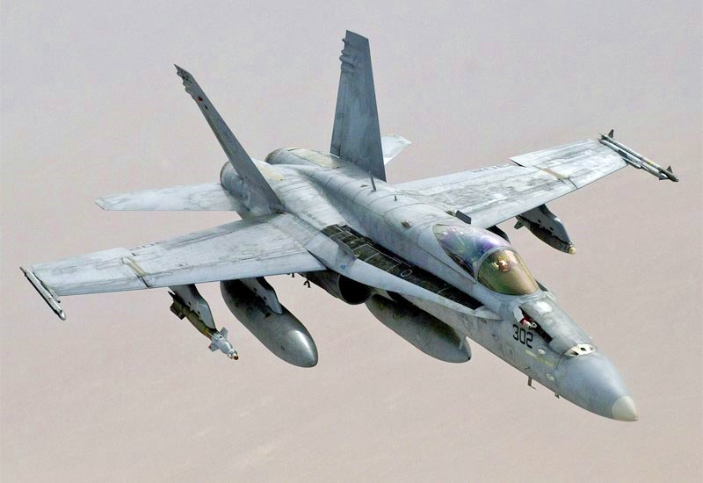
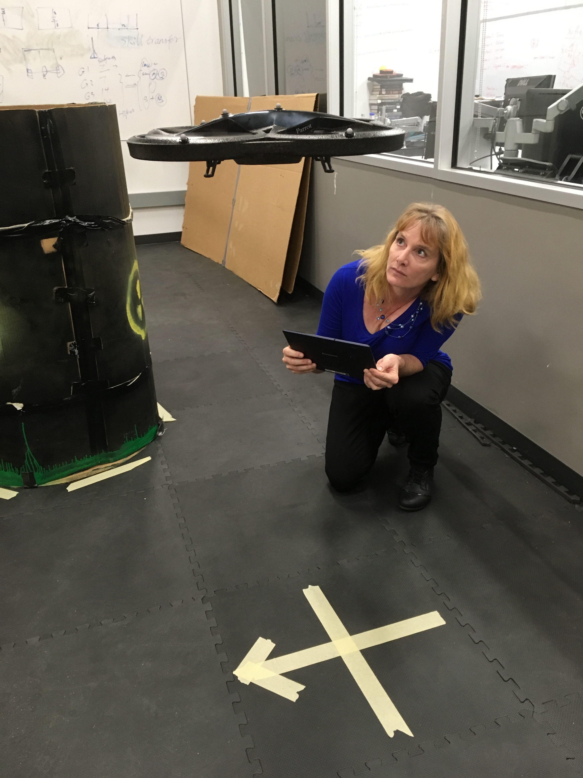
Notes:
Countess youtube videos that now show just how right I was

Slide 3
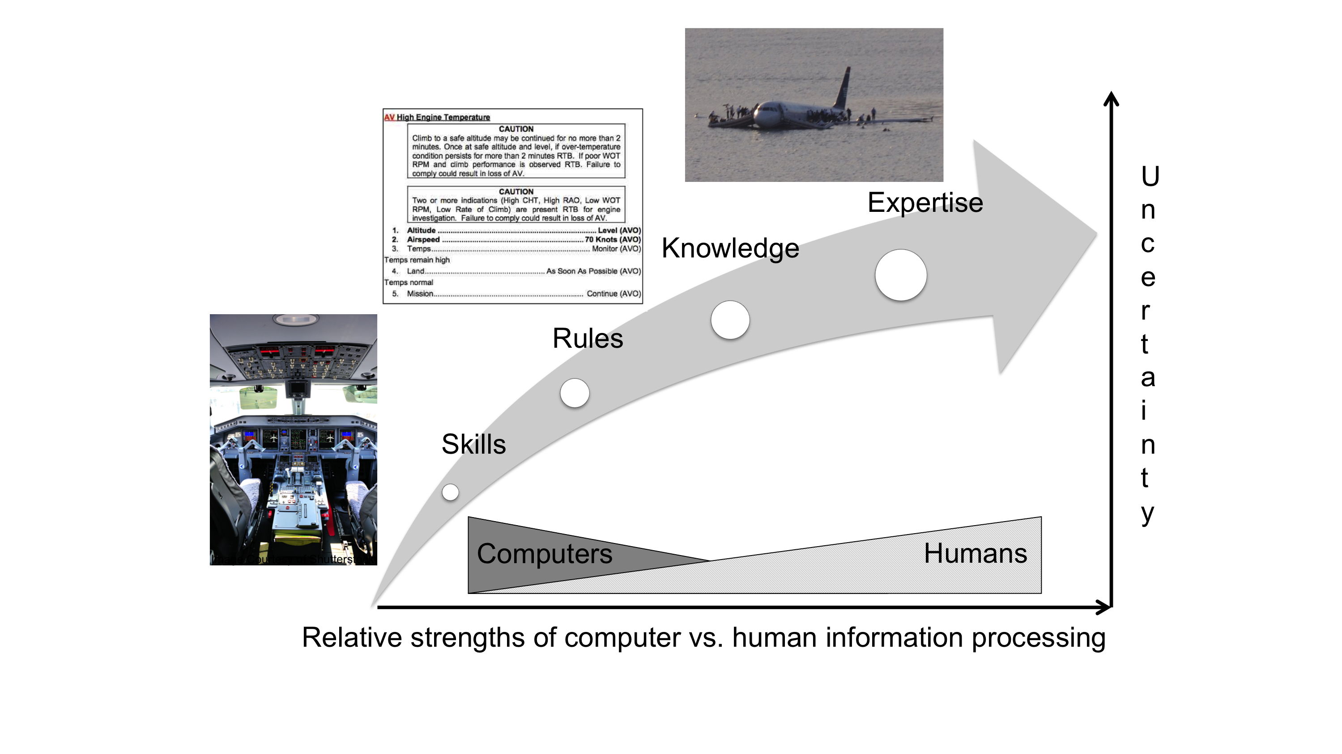
Skill-, Rule-, Knowledge- and Expert-based Behaviors

Slide 4
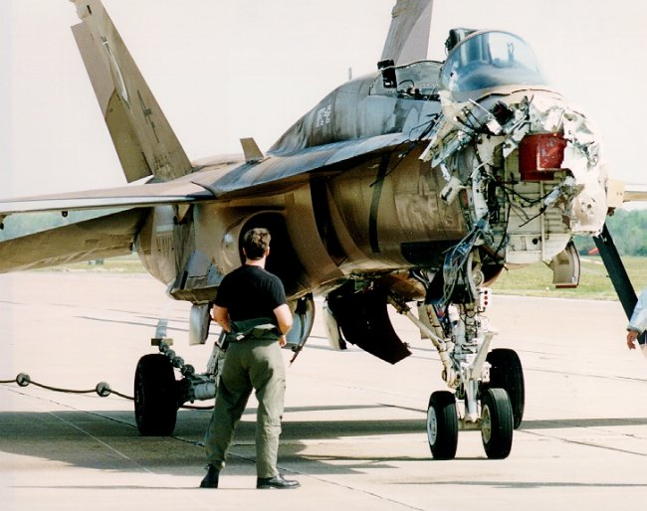
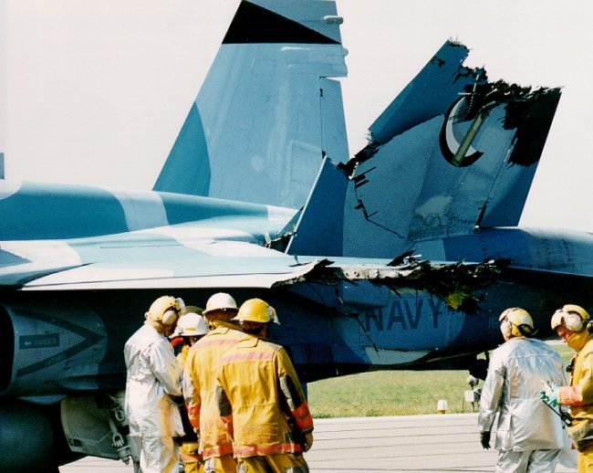
Automation can be eye-watering

Slide 5
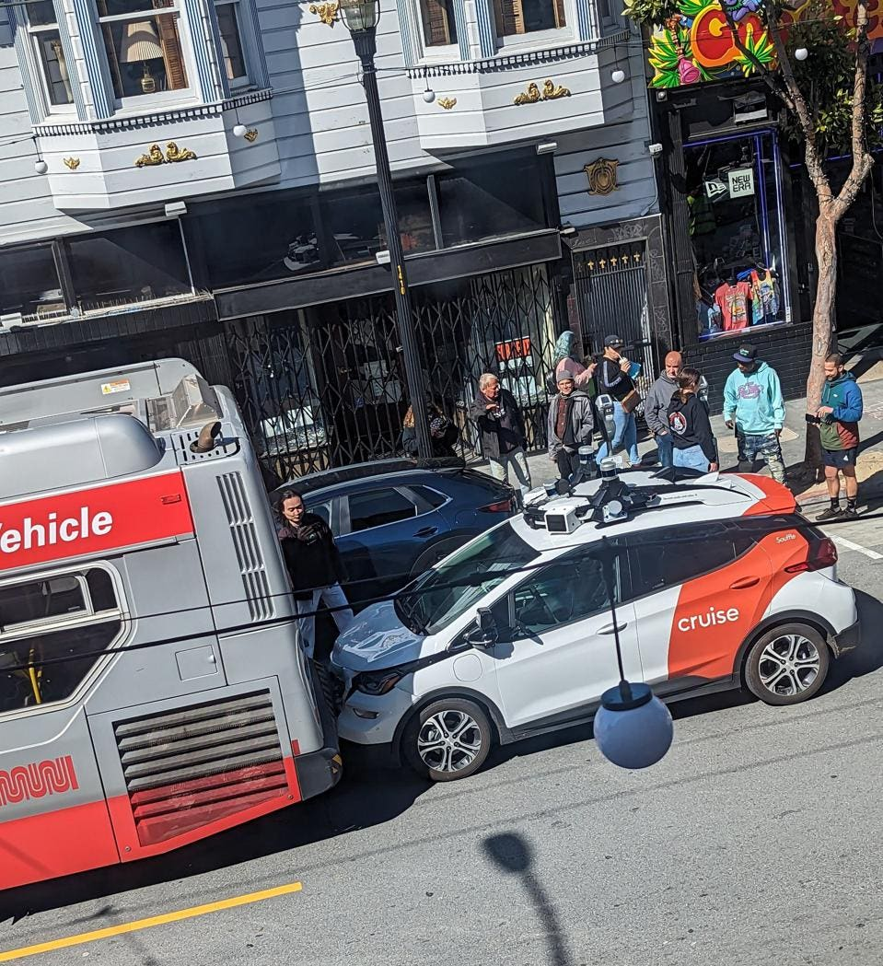
AI Skill-Based Reasoning in Practice

Slide 6
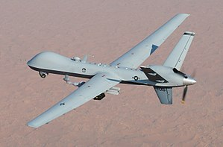
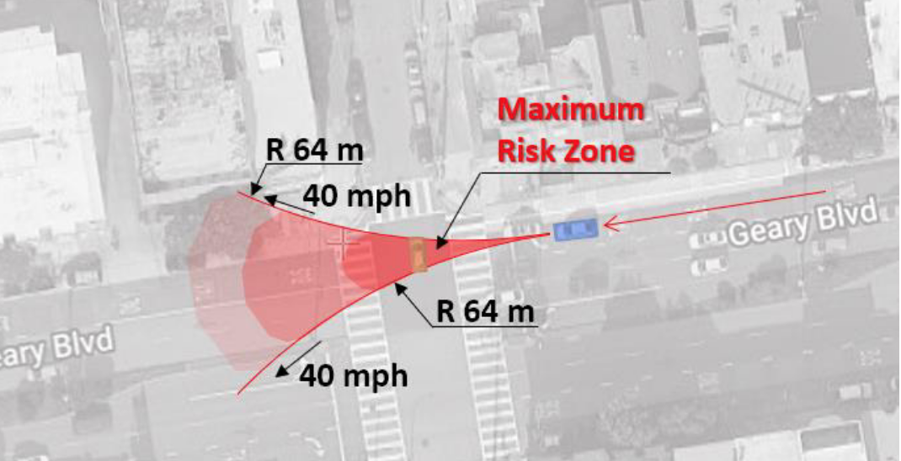
Rule-Based Reasoning in Practice
“The Cruise AV had to decide between two different risk scenarios and chose the one with the least potential for a serious collision.”
https://www.autoblog.com/2022/09/01/gm-cruise-autonomous-crash-recall/ and https://www.retrospectav.com/blog/unacceptably-risky-part-1-safety-report-on-cruises-crash

Slide 7

Knowledge-Based Reasoning in Practice

Slide 8
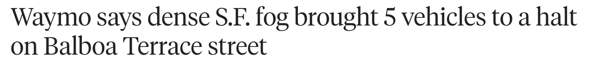
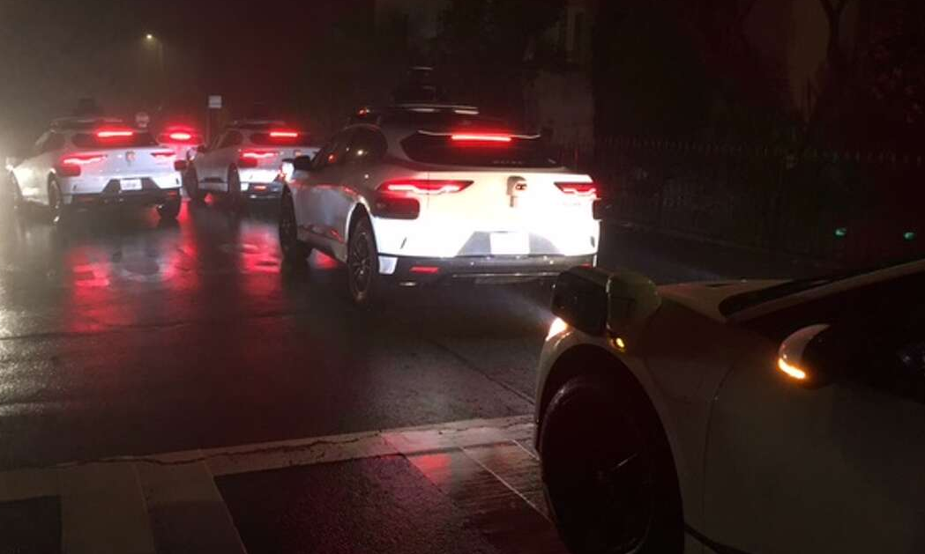
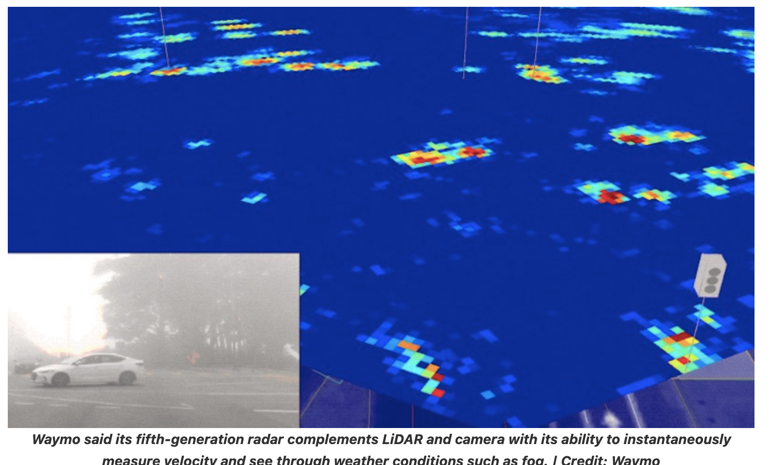
Knowledge-Based Reasoning in Practice
https://www.therobotreport.com/how-waymos-self-driving-cars-handle-fog-in-sf/

Slide 9
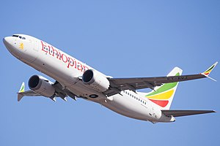
Knowledge-Based Reasoning in Practice

Slide 10
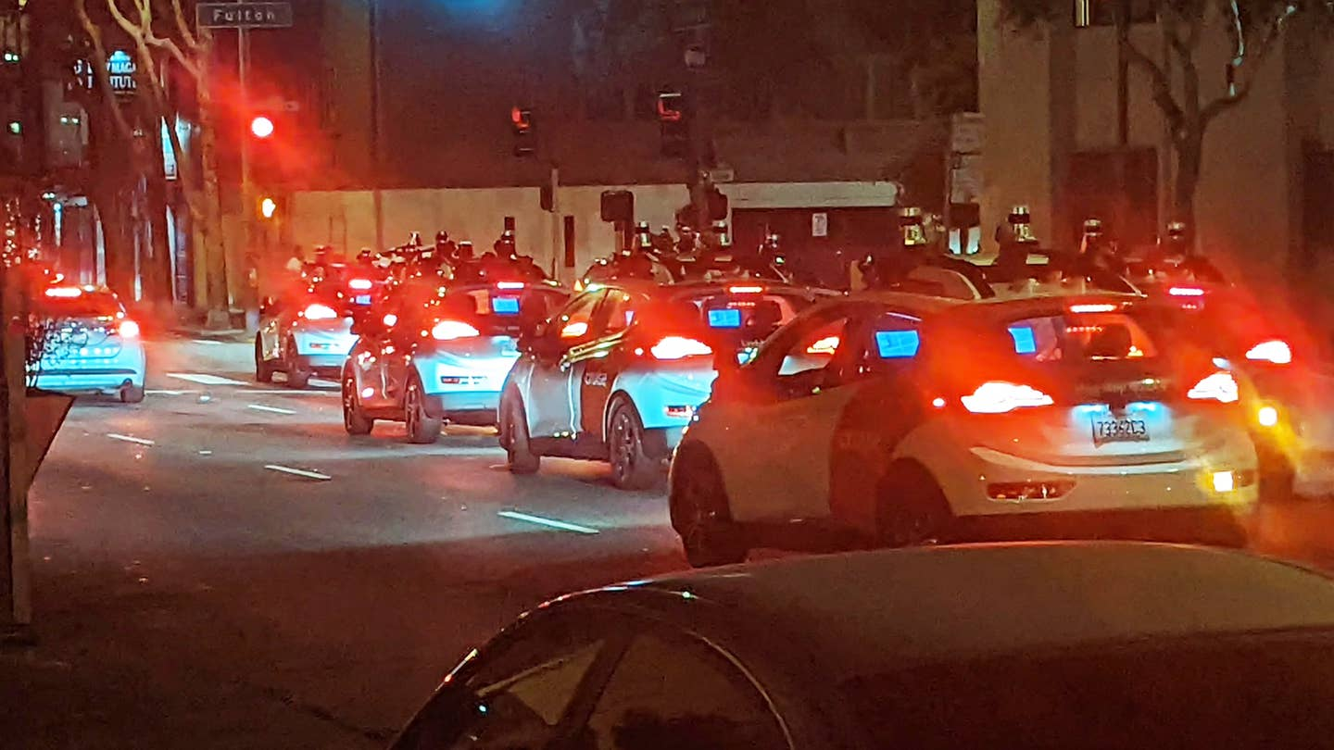
Expert-Based Reasoning in Practice
New forms of human-AV interaction are needed when things go wrong…
https://www.thedrive.com/news/a-swarm-of-self-driving-cruise-taxis-blocked-san-francisco-traffic-for-hours

Slide 11
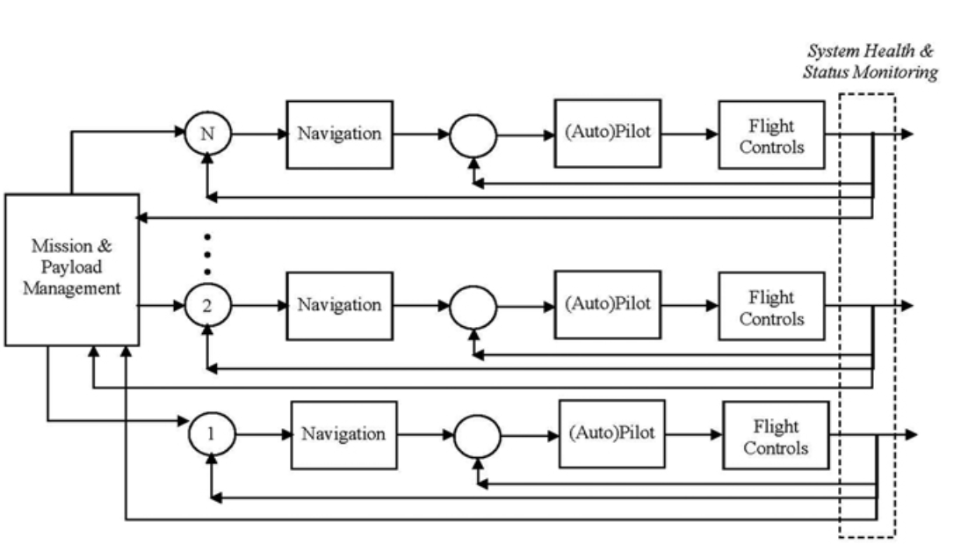
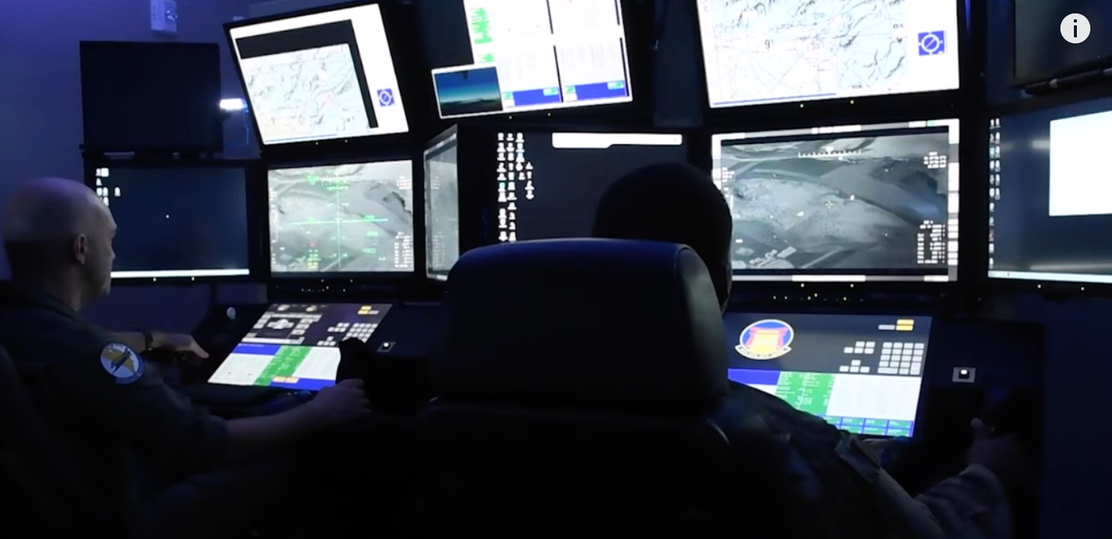
The Need for Remote Operations Experts
Notes:
Head of telsa autopilot (depo huang)
Both sides – NHTSA needs new category and industry needs to CTFD

Slide 12
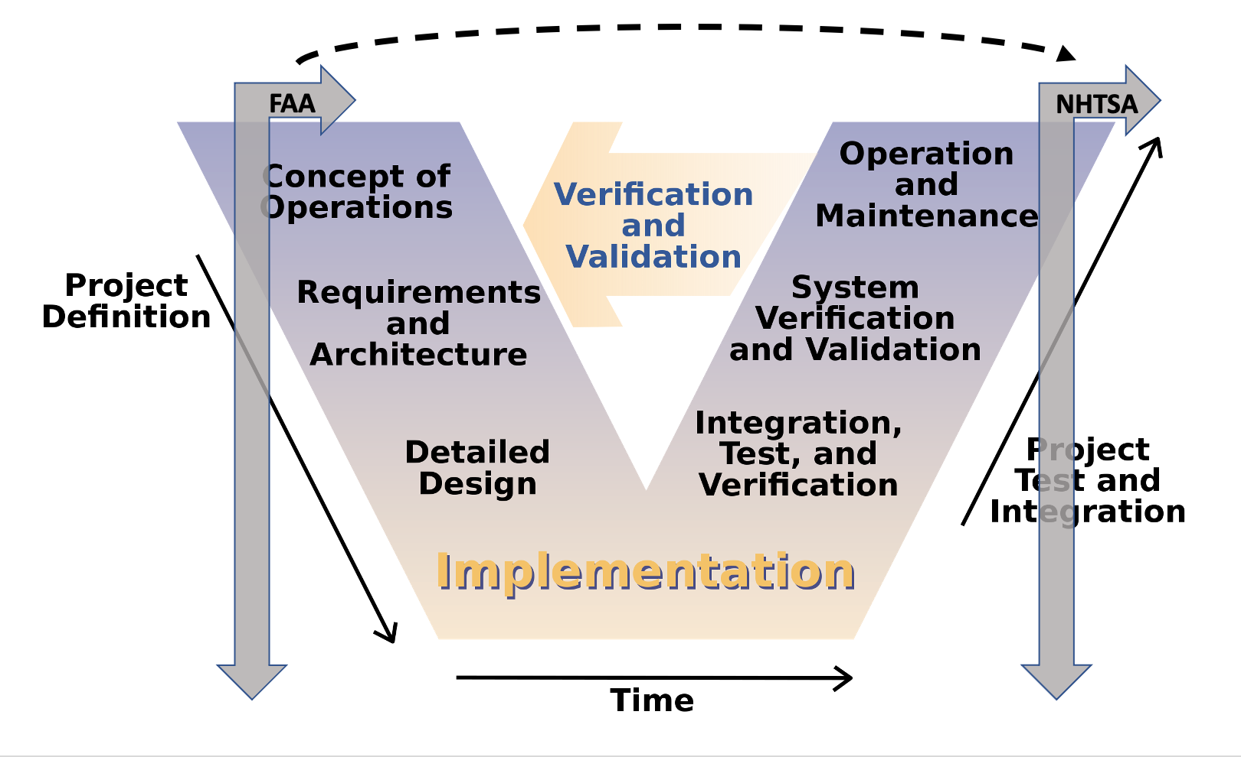
Certification Conundrums

Slide 13
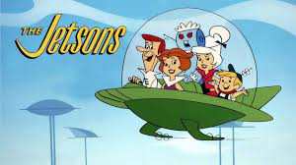
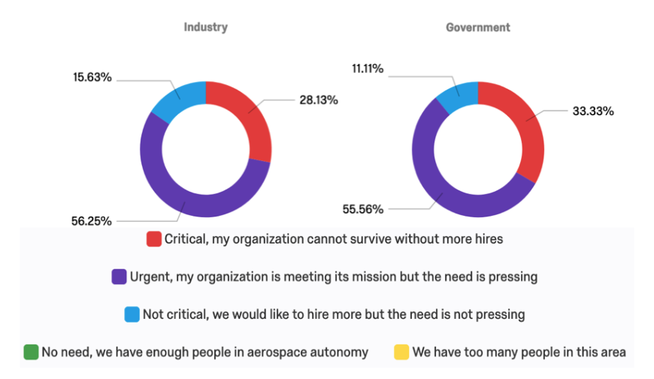
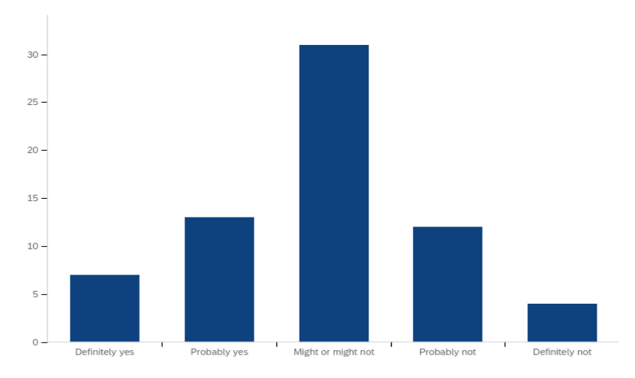
Looking Ahead
Will we get there?
Funding critical gaps in aviation autonomy vs. what’s cool
Workforce development
Notes:
Head of telsa autopilot (depo huang)
Both sides – NHTSA needs new category and industry needs to CTFD

Slide 14
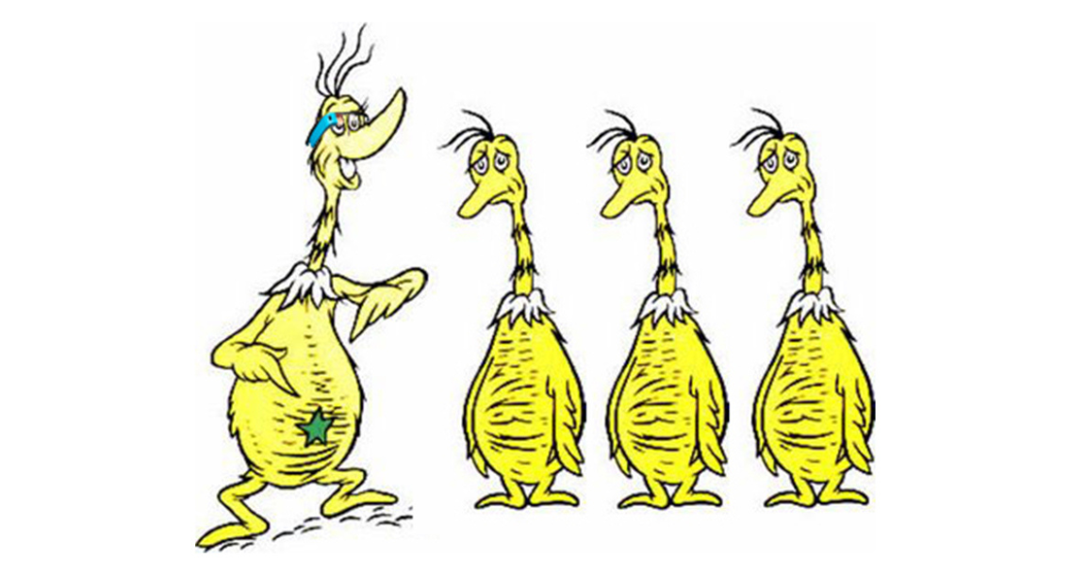
Questions?

